Slide 1
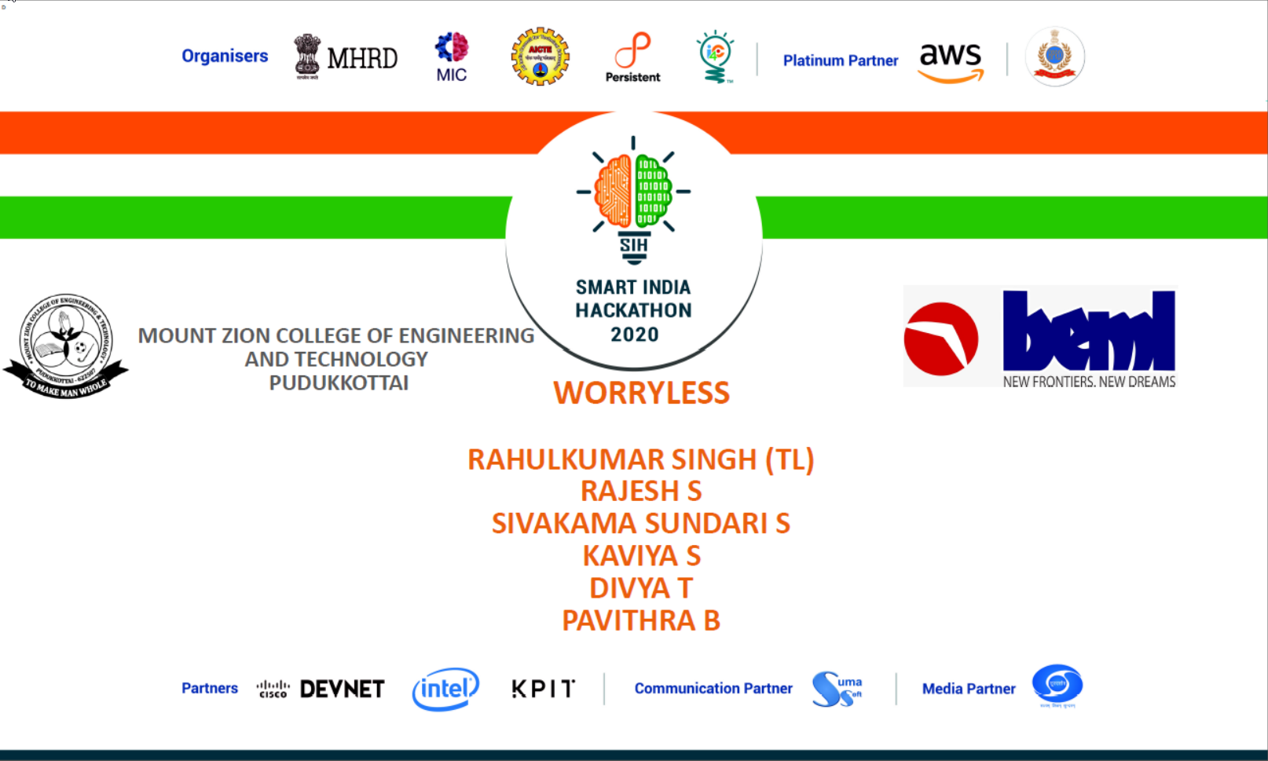

Slide 2
BH60M & BH100 with Electronic Transmission
Securing the CAN J1939 2.0B Communication Protocol, to make RIDES SAFER!

Slide 3
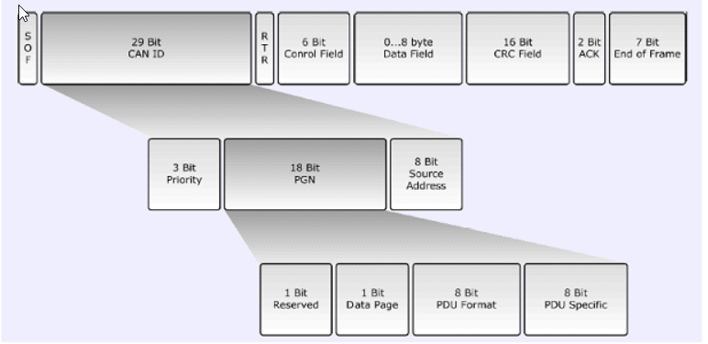
Understanding J1939 Frame

Slide 4
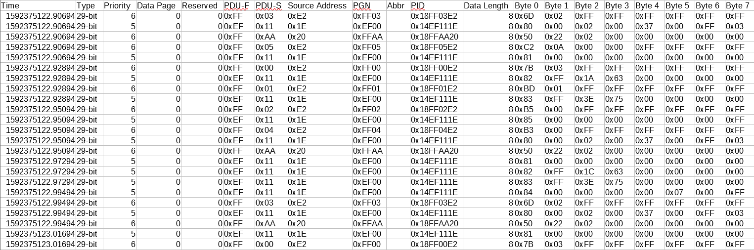
Understanding the Data in hand

Slide 5
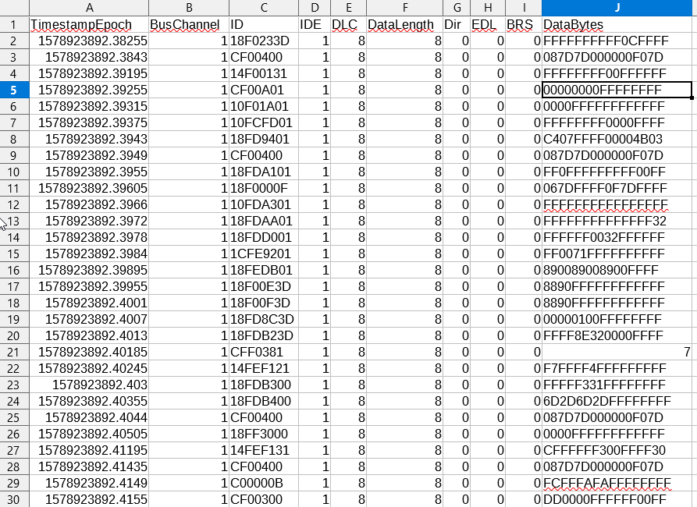
Converting my old CAN J1939 .mdf file to CSV file

Slide 6
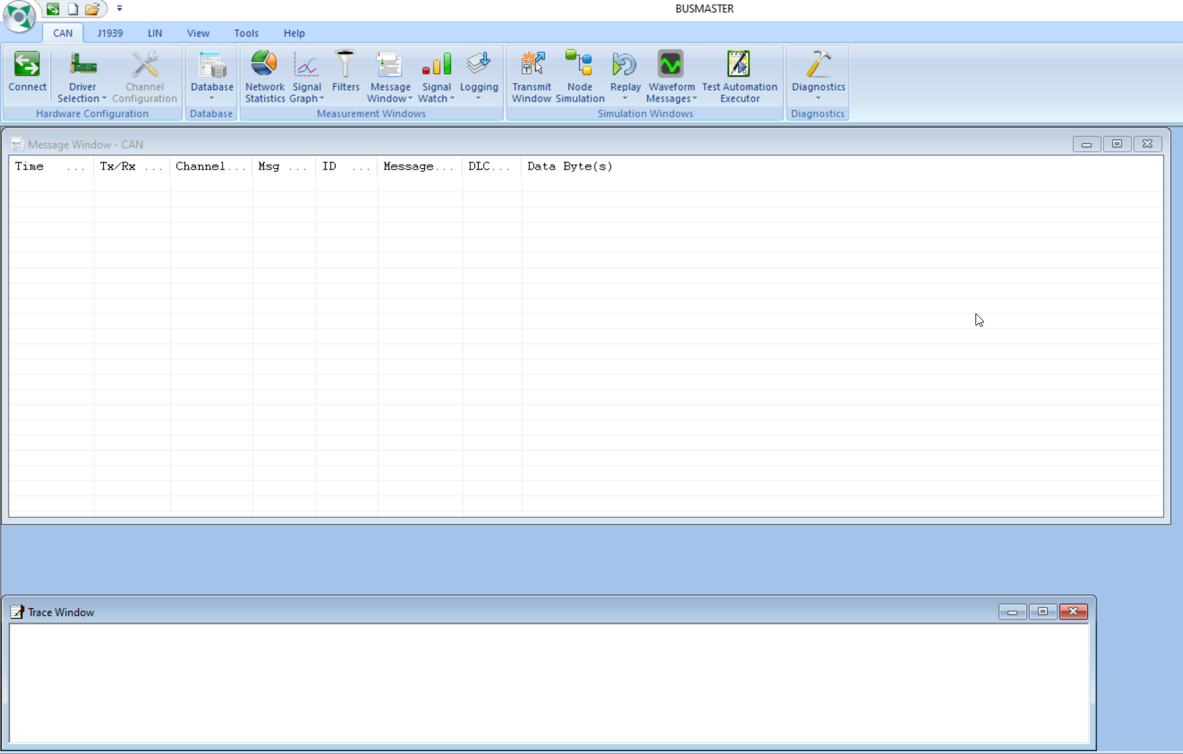
Further plan to create own DBC and CAN J1939 data using BusMaster

